Slide 1
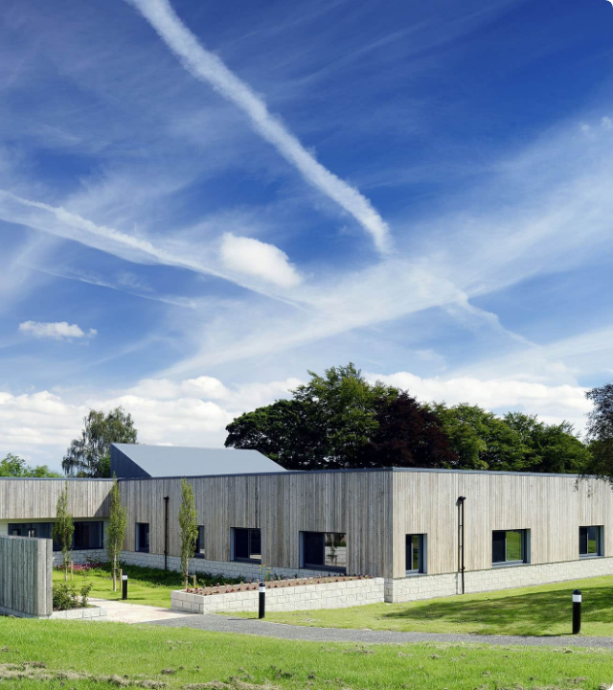
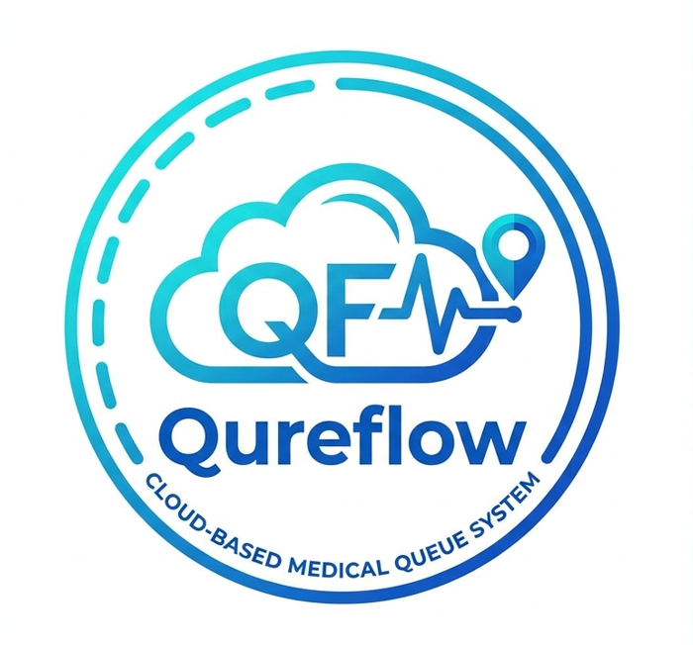
QureFlow
Smart Queue Management for Rural Healthcare
Revolutionizing patient flow, reducing wait times, and bringing clarity to healthcare facilities using robust AWS cloud technology.
Founders :
Kartikay Gupta (24BCI0109)
Sreyanko Sinha (24BCB0059)
Shaurya Samitkumar Shah (24BCI0095)

Slide 2


The Rural Healthcare Challenge
Unpredictable Wait Times
Resource Constraints
Patients in rural areas frequently travel long distances only to face severe overcrowding and highly unpredictable waiting periods, leading to dissatisfaction and health risks.
Clinics struggle with manual token systems. Without real-time tracking, administrative bottlenecks form, preventing doctors from focusing entirely on patient care.

Slide 3
Introducing QureFlow
Seamless Patient Coordination
Qureflow is a cloud-based smart queue management system specifically tailored for the unique challenges of rural healthcare facilities. By migrating from manual ledgers to an automated, digital token process, we eliminate chaos.
The platform orchestrates coordination seamlessly between patients, doctors, and healthcare workers.

Slide 4
Our mission is to democratize healthcare access by ensuring no patient in a rural setting loses critical time waiting in unmanaged queues.
"
"
The QureFlow Vision

Slide 5





Connecting the Ecosystem
Patients
Doctors
Health Workers
Empowered with remote queue joining and real-time token tracking to optimize their arrival time.
Provided with clear visibility of pending appointments and the ability to focus solely on consultations.
Equipped with tools for streamlined administrative control, emergency triage, and clinic management.

Slide 6


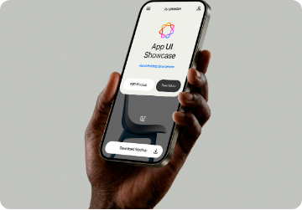
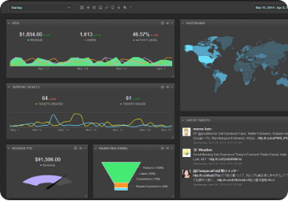
Core System Pillars
Cloud Native
Mobile First
Real-Time Sync
Reliable and scalable AWS backend ensures 99.9% uptime for remote clinics.
Accessible interfaces designed for standard smartphones prevalent in rural demographics.
Instantaneous updates on queue shifts and delays across all user endpoints.

Slide 7


Remote Queue Joining
Wait from Home, Not the Clinic
Qureflow enables patients to join a clinic's queue remotely from their devices. This drastically reduces physical overcrowding at the healthcare facility.
Patients receive a digital token and are only required to travel when their appointment is imminent, preventing the spread of communicable diseases in crowded waiting rooms.

Slide 8
Impact of Real-Time Tracking
80%
Minimizing Physical Wait Times
By implementing real-time token updates, clinics utilizing Qureflow experience a massive drop in physical waiting times, vastly improving the patient experience and clinic operational efficiency.
REDUCTION

Slide 9
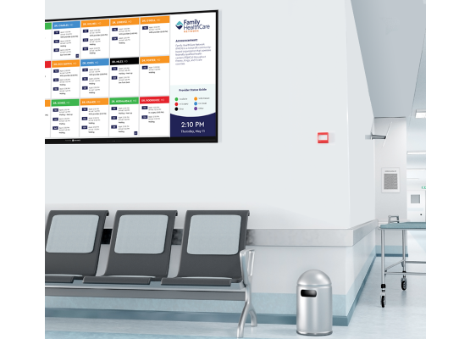


Algorithmic Estimated Wait Times
Dynamic Waiting Time Formula
QureFlow calculates live Estimated Wait Time (EWT) per patient using the dynamic throughput formula:
- t_active * p_active: Remaining active consultation time (if doctor is serving, p_active=1; else 0).
- (p - 1) * t_avg: Waiting load ahead (p patients ahead) multiplied by average consultation duration (10 min).
- buffer: Transit and sanitization overhead added per patient visit (2 min).
- Dynamic Slot Saturation: Live booking shows exact queue depth ("2 ahead, ~14m"). If EWT >= slot duration (30 min), the slot dynamically marks "Slot Full" to prevent clinic congestion.

Slide 10
Emergency Prioritization (Triage)
Critical Bypass Mechanism: Healthcare workers can override standard queues to push emergency cases to the front, updating all other tokens instantly.
Automated Notifications: If a queue is paused or delayed due to a severe triage case, awaiting patients receive an automatic status update on their devices.
Severity Flags: Medical staff can categorize the urgency of patients during registration to allow algorithms to suggest optimal slot placements.
Ethical Care Delivery: Ensures that standard queue management does not impede life-saving, immediate medical interventions.

Slide 11
Technical Architecture
A robust, scalable, and secure backend powered by AWS

Slide 12



AWS Service Integrations
AWS Compute & API
AWS DynamoDB
Cognito & Cellular SMS
High-throughput Node.js microservices executing dynamic wait time algorithms, slot capacity guards, and concurrency locks.
Single-Table NoSQL architecture (QureFlow-Main) with atomic counters and GSIs delivering sub-10ms queries for live queue tracking.
Enterprise identity with JWT Role-Based Access Control (RBAC), paired with Fast2SMS cellular dispatch for offline rural patients.

Slide 13
Core Technologies
Domain | Technology / Tool | Purpose
Frontend & UI | React 18 & Tailwind CSS | Responsive mobile-first client, dynamic slot capacity pickers, and real-time wait displays.
Backend API | Node.js & Express (TypeScript) | High-concurrency RESTful engine for EWT calculations, slot locks, and triage routing.
Database & Storage | AWS DynamoDB (Single-Table) | Unified schema (PK/SK), GSI1/2/3 indexing, and atomic FIFO token counter serialization.
Auth & Cellular SMS | AWS Cognito & Fast2SMS | Enterprise JWT role-based access control paired with cellular SMS alerts for rural patients.

Slide 14


Security & Authentication
AWS Cognito & JWT Authentication
Role-Based Access Control (RBAC)
QureFlow integrates authService with AWS Cognito and secure JWT token validation. Patient records, phone numbers, and consultation histories are encrypted in-transit (TLS 1.3) and at-rest.
Strict API route guards enforce granular permissions across Patients, Doctors, and Clinic Health Workers. DynamoDB conditional writes prevent double-booking and unauthorized queue modifications.

Slide 15


Scalable Data Management
DynamoDB Single-Table Architecture
The platform implements a unified Single-Table pattern (QureFlow-Main) via dynamoDbRepo.ts. Global Secondary Indexes (GSI1 for clinic schedules, GSI2 for active queues, GSI3 for emergency triage) eliminate slow table scans.
Atomic counters (ADD currentNumber 1) guarantee race-condition-free token generation under heavy concurrent booking loads, delivering sub-10ms latency with zero deadlocks.

Slide 16
The Patient Journey
Smart Booking
Prompt Consult
Selects clinic slot showing live load ("X ahead, ~Ym") with automated "Slot Full" guard.
Arrives just-in-time when called, completely bypassing crowded waiting rooms.
Mobile Auth
Live Tracking
Patient registers or logs in via phone number OTP, verified through AWS Cognito / JWT.
Monitors real-time EWT countdown, token position, and receives cellular SMS reminders.

Slide 17
The Doctor & Worker Journey
Token Chime & Next
Load & Triage
Marks visit complete; system triggers automated chime sound and summons the next token.
Monitors patient load and flags emergencies for instant top-of-queue bypass via GSI3.
Shift Activation
Active Console
Doctor / Health worker launches daily clinic console and activates live queue reception.
Conducts consultation with live elapsed timer, patient vitals, and diagnostic notes.

Slide 18



Clinic Administration Modules
Clinic Setup
Doctor Management
Analytics
Register new rural healthcare facilities, manage locations, operating hours, and general capacity limits.
Link medical professionals to specific clinics, define their specialties, and set their active shifts.
Review historical data on peak hours and average consultation times to optimize future scheduling.

Slide 19
Healthcare Impact
Measuring the success of Qureflow

Slide 20
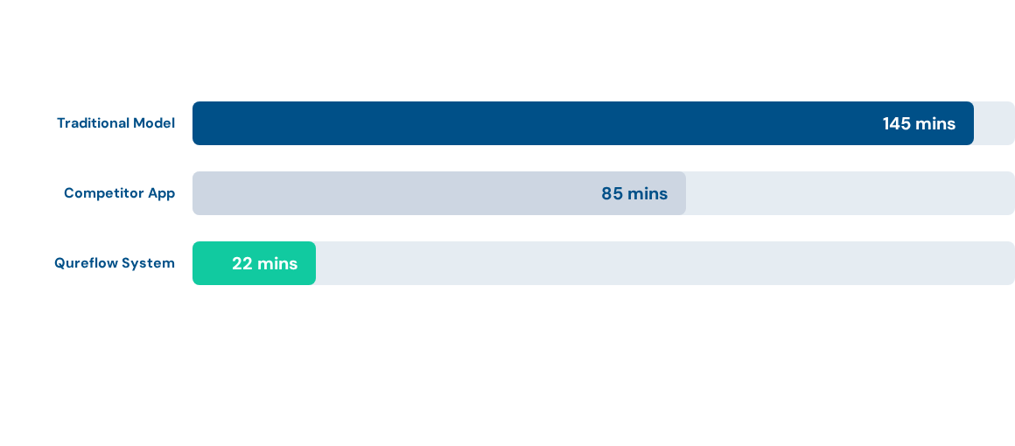
In-Clinic Wait Times (Minutes)
Qureflow drastically reduces physical wait time, outperforming traditional ledger systems by over 80%.

Slide 21
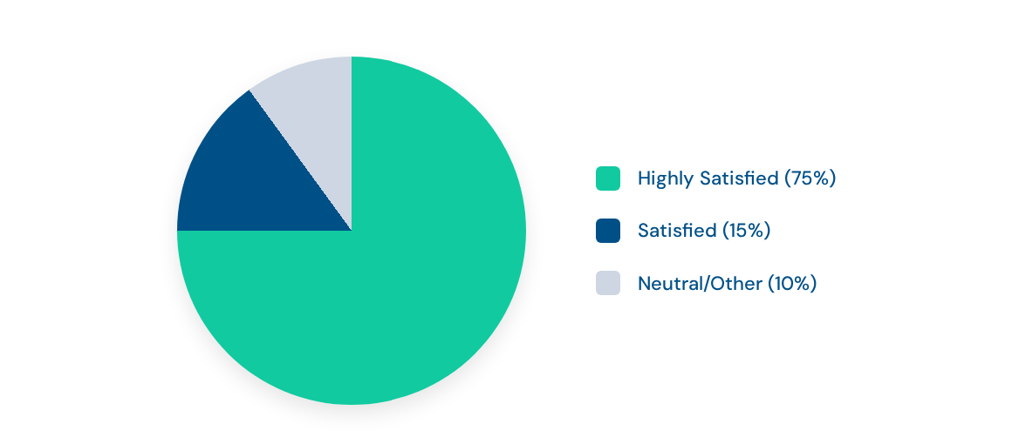
Post-Deployment Patient Satisfaction

Slide 22
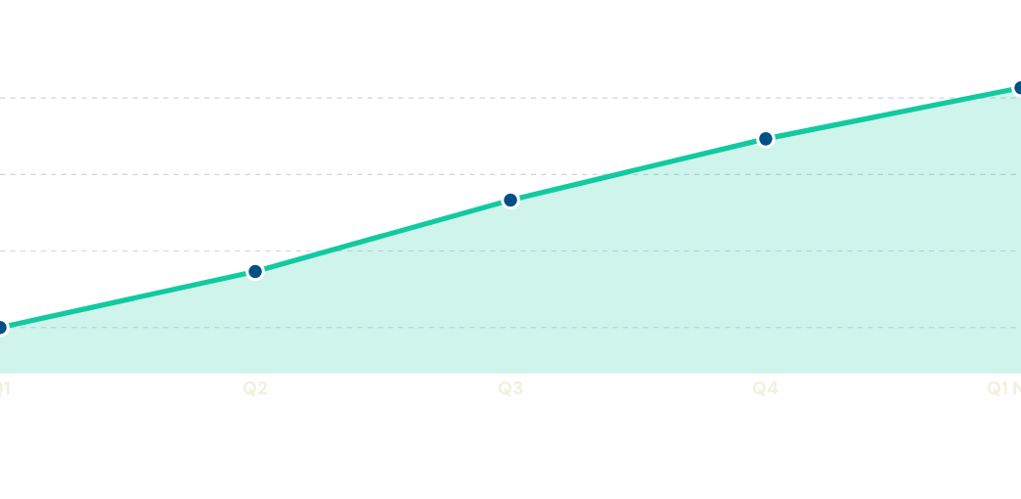
Projected Clinic Onboarding
Exponential growth in platform adoption across rural health networks.

Slide 23
Strategic Advantages of Qureflow
Zero On-Premise Infrastructure: Entirely cloud-hosted via AWS, requiring zero hardware investment from resource-strapped rural clinics.
BYOD (Bring Your Own Device): Operates flawlessly on existing smartphones owned by patients and healthcare workers.
Rapid Deployment: New clinics can be onboarded, configured, and operational within hours, rather than weeks.
Sustainable Practice: Eliminates paper waste from ledgers and physical tokens while reducing the carbon footprint of unnecessary travel and idling.

Slide 24


A Healthier Tomorrow
Qureflow is more than a queue management tool; it is a vital bridge connecting rural patients to the healthcare they deserve, without the burden of the wait.

Slide 25
Questions?
Thank you for exploring QureFlow.
www.qureflow.cloud | support@qureflow.com

Slide 26






Image Sources
https://www.ads.org.uk/sites/default/files/2022-06/stratheden-ipcu-exterior-entrance-large-2017-Nigel-Rigden.jpg
Source: www.ads.org.uk
https://legacy.freerangestock.com/sample/110062/cloud-computing---cloud-infrastructure---abstract-background---d.jpg
Source: freerangestock.com
https://images.pixeden.com/images/app-ui-presentation-psd-mockup-hand-holding-smartphone_full_preview_retina.jpg
Source: www.pixeden.com
https://anvil.works/forum/uploads/default/optimized/1X/d04df53393aad88c80b91a0aa5c79d3363a8eb2c_2_1024x628.jpeg
Source: anvil.works
https://frontiertech.niti.gov.in/wp-content/uploads/2025/06/medical-banner-with-doctor-wearing-gloves-6-3.jpg
Source: frontiertech.niti.gov.in
https://www.savanceworkplace.com/wp-content/uploads/hospital-digital-waiting-room-display-hipaa-compliant-wall-scene.png
Source: www.savanceworkplace.com

Slide 27


Image Sources
https://img.magnific.com/premium-vector/cloud-storage-internet-database-data-security-concept-flat-illustration_720185-3934.jpg
Source: www.magnific.com
https://ihm.edu.au/wp-content/uploads/2026/04/smiling-caretaker-male-pensioner-focused-reading-news.jpg
Source: ihm.edu.au

